Slide 1
Python-Lecture 1(introduction)
By-Pratik Sanghvi

Slide 2
The Python Programming Language
High level language – very near to English or other human language (Eg: C, C++)
Low level languages are referred as machine level languages Eg: Assembly Language etc.
High level language needs to be first converted in low level languages to be run
High level languages are portable(can be run on different computers with few or no changes) in comparison to low level languages

Slide 3
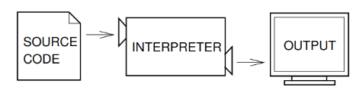
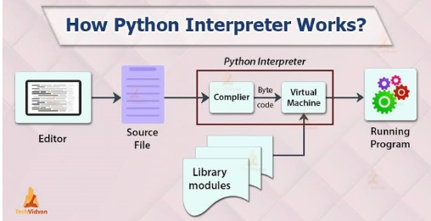
Python Interpreter
Source: Think Python PDF
Source: DataScienceCentral.com
Ex of Python Interpreter: Cpython, PyPy, Stackless Python
Detailed info: https://doc.pypy.org/en/latest/architecture.html#pypy-python-interpreter

Slide 4
Interactive and Script mode
>>> - known as chevron indicates that the interpreter is active
Mostly interactive mode is usually used to test or verify any python statement
Script mode can be accessed from the command prompt in the following way: Python testprogram.py
If you have more than a line of python code, you should write a script and then execute it.

Slide 5
History
It was in late 1980’s, when Guido van Rossum came up with an idea to develop a programming language while working in CWI(Centrum Wiskunde and Informatica), Amsterdam, for a project named Amoeba which is a distributed operating system.
Rossum being a big fan of a British sketch comedy series, Monty Python’s Flying Circus, named the language as Python.
Python came into sight on 20 Feb, 1991 for the very first time.

Slide 6
Features
Easy to Read, Learn and Use
Interpreted Language
Portable
Free and Open Source
Huge Library
Cross-Compilation
https://www.w3trainingschool.com/python-introduction-history-features

Slide 7
Installing Python
Download the Windows installer from the python website
Run the installer and make sure you select the add to path option
It’s going to take a while to install and you should be good
To check the installation go to command prompt and type python
If it goes thorough and you get the prompt you are good

Slide 8
Running Python program
Write a program to calculate cube of 2
Run the above program using the python command

Slide 9
Debugging
Syntax Errors – Errors made while writing Python statements
Runtime Errors – Errors which are also referred to as exceptions
Semantic Errors - The logic of the program is not what you intended it to be
Experimental Debugging – write a program that accepts an integer from command line. Do experimental debugging for the case of entering a float number from the command line.

Slide 10
Formal and Natural Languages
Natural languages are the languages people speak
Formal languages are ones which are designed for specific application like mathematics, programming languages and chemical structure.
Formal languages tend to have strict rules about syntax. So details matter
Syntax rules come in two flavors, pertaining to tokens and structure.
Tokens can be words, numbers or chemical elements
Structure is how the tokens are arranged together in a legal way
Figuring out the structure of the language is called parsing

Slide 11
The difference between round brackets, curly brackets, and square brackets
Round brackets are used to define tuples and expressions Eg. (1,2,2), (3+2)
Curly Brackets can be used to define dictionaries eg: {‘A’:1,’B’:2}
Square brackets are used to define lists eg: [‘X’,’Y’,’Z’],[1,2,3], dict[‘A’]

